Slide 1
PERSONAL WORK REPORT · WEEK 3
My work on the Pre-Thesis Demo
Mr. Kongkidakorn Chuayjang · Head Programmer
REPORTING WEEK
PROJECT
SUB PROGRAMMER
Week 3 · 8–12 Sep 2026
Pre-Thesis Demo · Unity 6.5 + Mirror + EOS
Mr. Atiroj Kemwanicha
Every claim in this deck is traceable to a commit in the team repository.
Notes:
The next slide sets the boundary between my work and my teammate's before anything is claimed.

Slide 2
BEFORE ANYTHING ELSE
What is mine, and what is not
This project has two programmers. This slide draws the line so nothing later is ambiguous.
MY WORK
THEIRS, REWRITTEN BY ME
ATIROJ'S WORK
Written by me
Shared ownership
Not mine
Save system (encrypted)
Room creation & matchmaking
Room browser data layer
Offline / online mode switch
Scene-persistence utilities
Editor tooling
Persistent HUD root
Atiroj designed and wrote these as single-player systems. I rewrote them to run under server authority for six players.
Written by Atiroj and merged into my branch. I am not claiming any of it.
Original single-player design of the systems in the middle column
Downed / revive feature (≈180 lines)
Gameplay prop setup in test scenes
Interaction system
Health & damage
Player movement
First-person camera
Health bar UI
Evidence for this split: my own commits versus the three merges that brought Atiroj's work in.
Personal Work Report | Kongkidakorn Chuayjang
01
Notes:
If the room remembers one slide, it is this one. Left = mine. Right = Atiroj's. Middle = his idea, my multiplayer rewrite.

Slide 3
100% MINE
MY WORK · 01
Encrypted save system
What it does
A decision I want to defend
Writes progression as AES-256 encrypted JSON — not readable or editable in a text editor.
Loads automatically before the first scene, so no system has to ask whether a save exists.
One static source of truth — no component keeps its own copy to drift out of sync.
Permanent items capped at one copy, removed on drop, trade or death.
Custom Inspector shows live save contents during Play, so progression bugs are visible without a debugger.
The encryption key is not stored as one string. It is split into four byte arrays and assembled at runtime.
// no single string to grep
// out of the binary
keyPart1 … keyPart4 → GetKey()
A determined attacker with the binary still wins — true of any client-side save. The achievable goal is narrower: make casual save editing not worth the effort, which is what damages a co-op economy.
347 lines · 4 files
Personal Work Report | Kongkidakorn Chuayjang
02

Slide 4
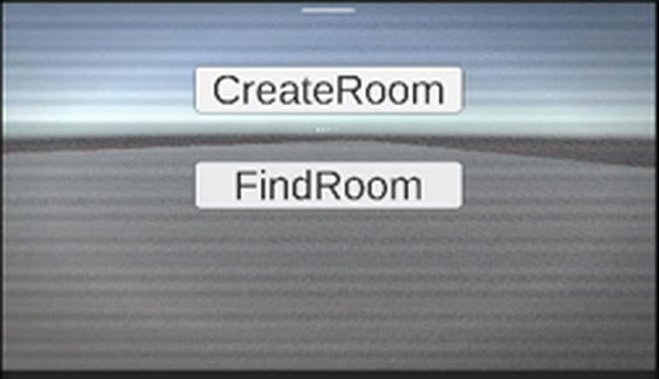
100% MINE
MY WORK · 02
Room creation & matchmaking
1
A room is a data contract, not a button
Map, difficulty, player limit and privacy live in one validated structure. The UI cannot create a room the join path can't read.
2
The browser knows before you join
Each room advertises map, difficulty, lock state and a live 2/6 player count — so a player picks a room instead of gambling.
From my playtest recording
Create Room opens a lobby on Epic's service and starts hosting. Find Room searches and returns every open room.
3
Passwords are never a room attribute
I read Epic's lobby API: attributes marked private are still readable by anyone searching. So the password is verified after joining.
450 lines · 5 files
Personal Work Report | Kongkidakorn Chuayjang
03

Slide 5
HIS DESIGN · MY REWRITE
MY WORK · 03
Making Atiroj's systems multiplayer-safe
Atiroj wrote the interaction and health systems as single-player code, which is the right way to write them. My job was the rewrite that makes them survive six players and a hostile client.
BEFORE — single-player
AFTER — server-authoritative
Interaction
Pressing E ran the door's code directly on the machine that pressed it.
The client asks the server which object it wants. The server re-checks distance before opening anything.
Health & damage
A collider applied damage locally, so each machine saw a different health value.
Only the server applies damage; health syncs outward. Every player sees the same number.
Player control
Every copy of the player prefab read the keyboard — one key press moved all of them.
Only the locally owned player reads input. Remote copies are driven by the network.
Late joiners
A player joining after a door opened saw it closed.
State is re-applied on connect, so the world is consistent mid-run.
Credit where it is due: the features are Atiroj's. The networking model they now run on is mine.
Personal Work Report | Kongkidakorn Chuayjang
04
Notes:
Say this out loud: I did not invent these features. I made them safe to run over a network.

Slide 6
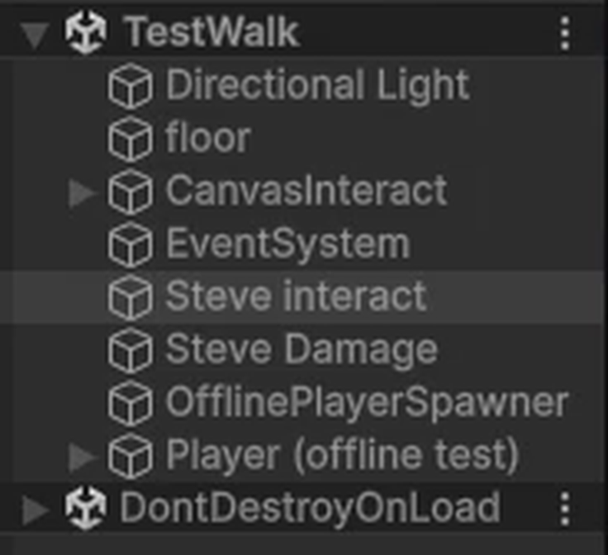
100% MINE
MY WORK · 04
Letting the team test without hosting a match
The problem
Mirror switches off every scene object carrying a network identity so the server controls when it appears. Correct in a match — and it means a teammate pressing Play in a test scene watches every prop vanish.
What I built
One offline check every system consults, so gameplay code is written once and behaves correctly with or without a server.
A spawner that places a test player and restores the objects Mirror disabled — and does nothing once a match is running.
Persistence helpers so the Epic manager and HUD survive scene changes instead of being destroyed mid-match.
TestWalk in Play mode — props still present
Honest note: this took three attempts. The first two assumed Mirror disables objects before Awake — it does not.
Personal Work Report | Kongkidakorn Chuayjang
05

Slide 7
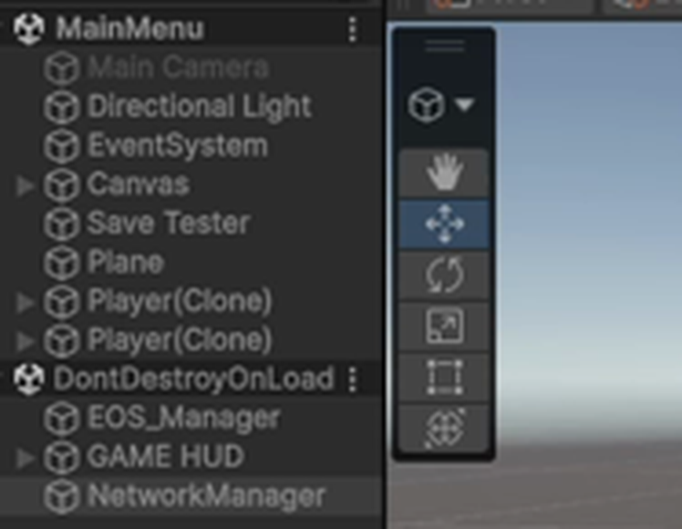
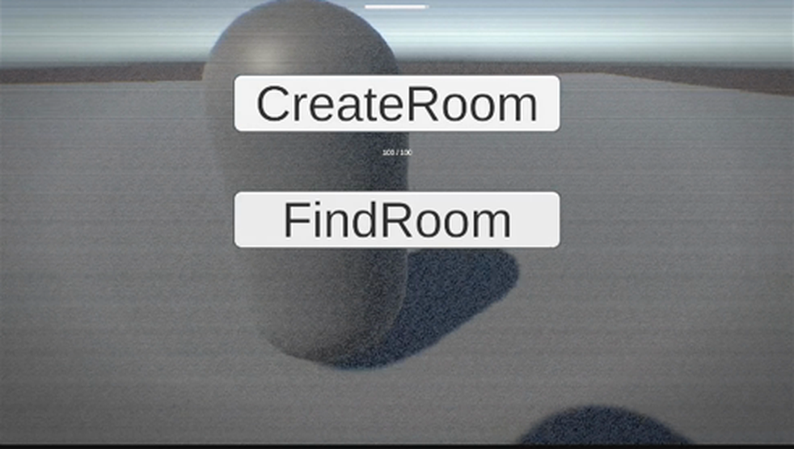
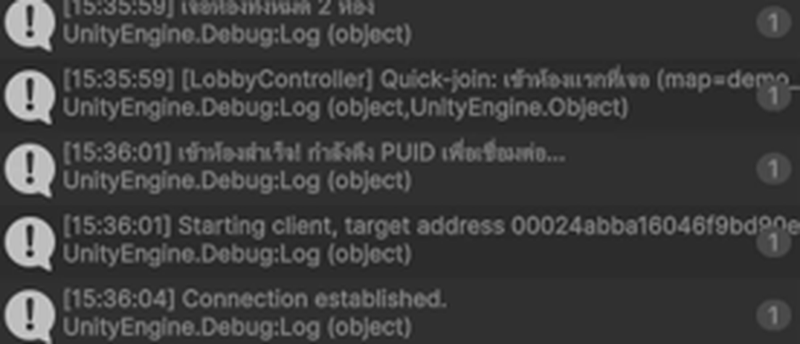
EVIDENCE · 12 SEP 2026
Playtest — two machines, one world
Connection established
The client resolved the host's Epic user ID and connected through it — no IP address involved.
Two Player(Clone) in one scene
Host and joined client both present.
The other player, seen from my client
Recordings supplied with this deck
13-48-04.mp4 (0:54) — offline sandbox: interactables stay present, damage trigger fires
15-35-02.mp4 (1:18) — creating a room on Epic and starting the host
15-35-42.mp4 (0:40) — second client finds the room, joins, both players appear
Personal Work Report | Kongkidakorn Chuayjang
06
Notes:
Play the three recordings here if there is time. The frames on this slide are pulled from them.

Slide 8
MY WORK · 05
Bugs I found by reading, not guessing
Each had a plausible wrong explanation that would have cost days. I found the real cause in the library's own source.
SYMPTOM
REAL CAUSE
WHAT I DID
Build would not compile
Two Epic SDKs installed at once, colliding on the same native library.
Removed the unused one. 0 errors, 0 warnings.
1
Client joined an empty world
A server can spawn a prefab it references; a client can only spawn one that is registered.
Identified the checkout mismatch.
2
Props disappeared on Play
Mirror disables scene objects after Awake, so an Awake-time fix runs too early.
Rewrote the fix to watch across frames.
3
Rooms rejected with InvalidUser
Epic login is asynchronous; the button could be pressed before login finished.
Gated room creation on login state.
4
Damage did nothing
Detection relied on a tag the spawned prefab did not carry.
Detect by component instead of tag.
5
Personal Work Report | Kongkidakorn Chuayjang
07

Slide 9
FORWARD
What I am doing next
1
Room browser UI
The search already returns every open room with map, difficulty, lock state and player count. Nothing draws it yet — that is my next build.
2
Move the match into a real scene
The online test currently runs in the menu scene. Next is a proper level load with players spawning into it.
3
Private-room passwords
Design is settled — verified after joining, never advertised. Implementation is mine.
4
Start the 13 Rules system
The design thesis of the game, still unstarted. I want it under way before it becomes the thing we ran out of time for.
I will report against this list in next week's personal presentation.
Personal Work Report | Kongkidakorn Chuayjang
08

Slide 10
SUMMARY · 12 AUG – 12 SEP 2026
Everything I have built so far
Written from scratch
Rewritten for multiplayer
Verified working
AES-256 encrypted save system with auto-load
Permanent items capped at 1, lost on drop or death
Custom Inspector for live save contents
Room creation on EOS → Mirror host, and room search
Room data contract: map, difficulty, limit, privacy
Offline / online mode switch + scene persistence
Editor tooling for network setup checks
Interaction → client asks, server validates range
Health & damage → server-only, synced outward
Player control → only the owned player reads input
Camera → remote cameras and listeners disabled
Late joiners → state re-applied on connect
Health bar UI → binds to the local player only
Two machines in one session over Epic
Both players spawn, move and see each other
Room created with full config carried across
Solo sandbox scenes run with no server
Build compiles with 0 errors and 0 warnings
1,360
lines written from scratch
1,461
lines rewritten for multiplayer
11
commits of my own
5
hard bugs root-caused
Personal Work Report | Kongkidakorn Chuayjang
Week 3
Notes:
Close on this. The rewrite column is the harder half — changing working code so it behaves identically for one player and correctly for six, without breaking what Atiroj built. None of this is visible in a screenshot of the game; all of it is the reason there is a game to screenshot.

